Slide 1
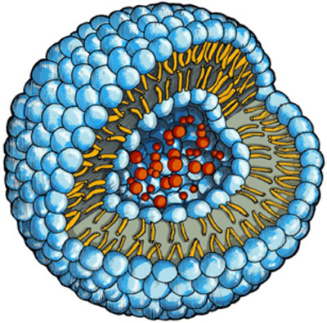
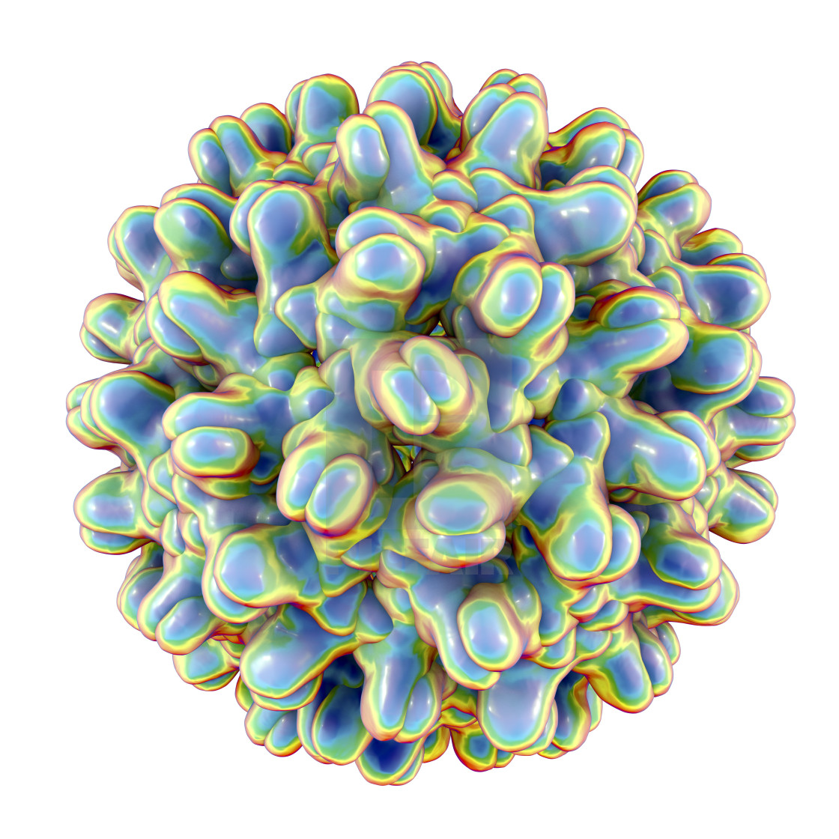
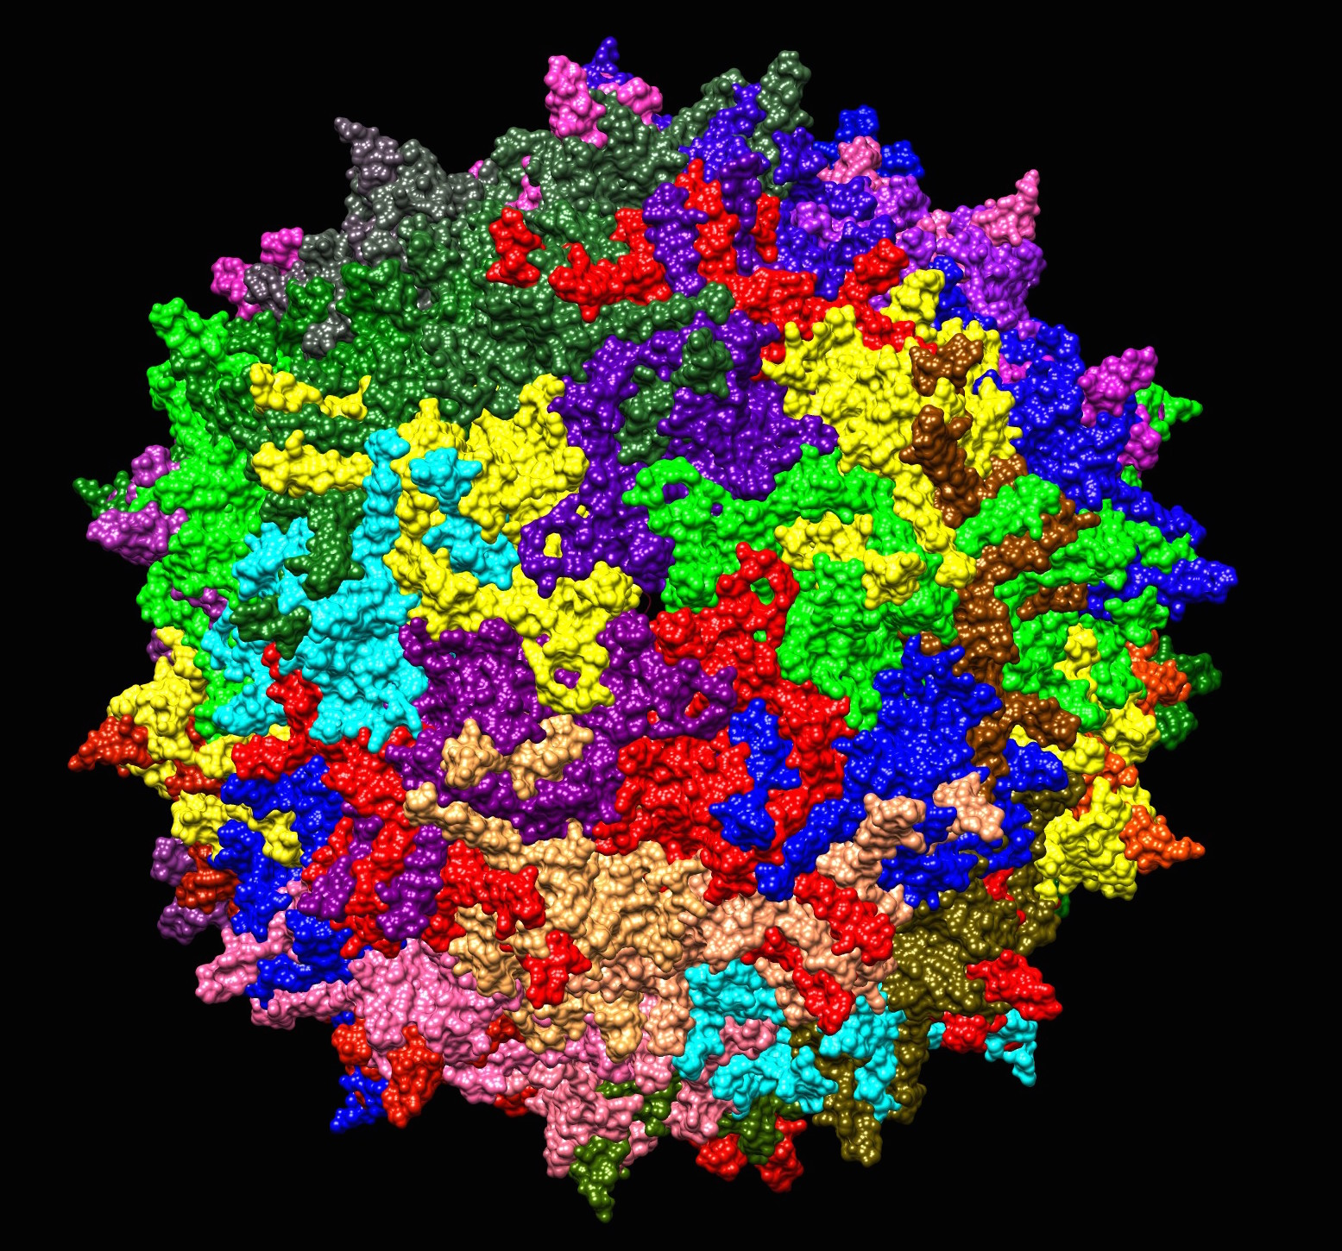
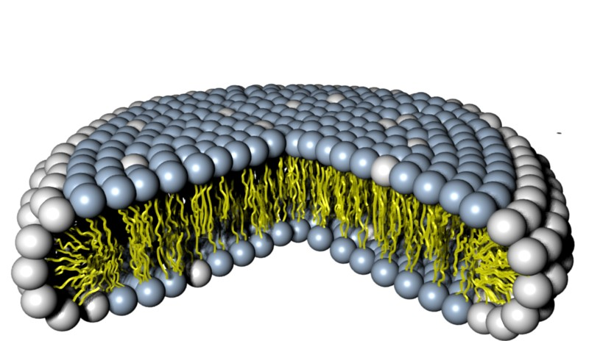
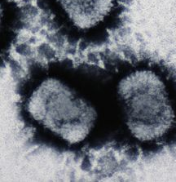
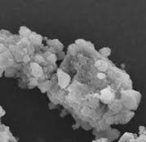
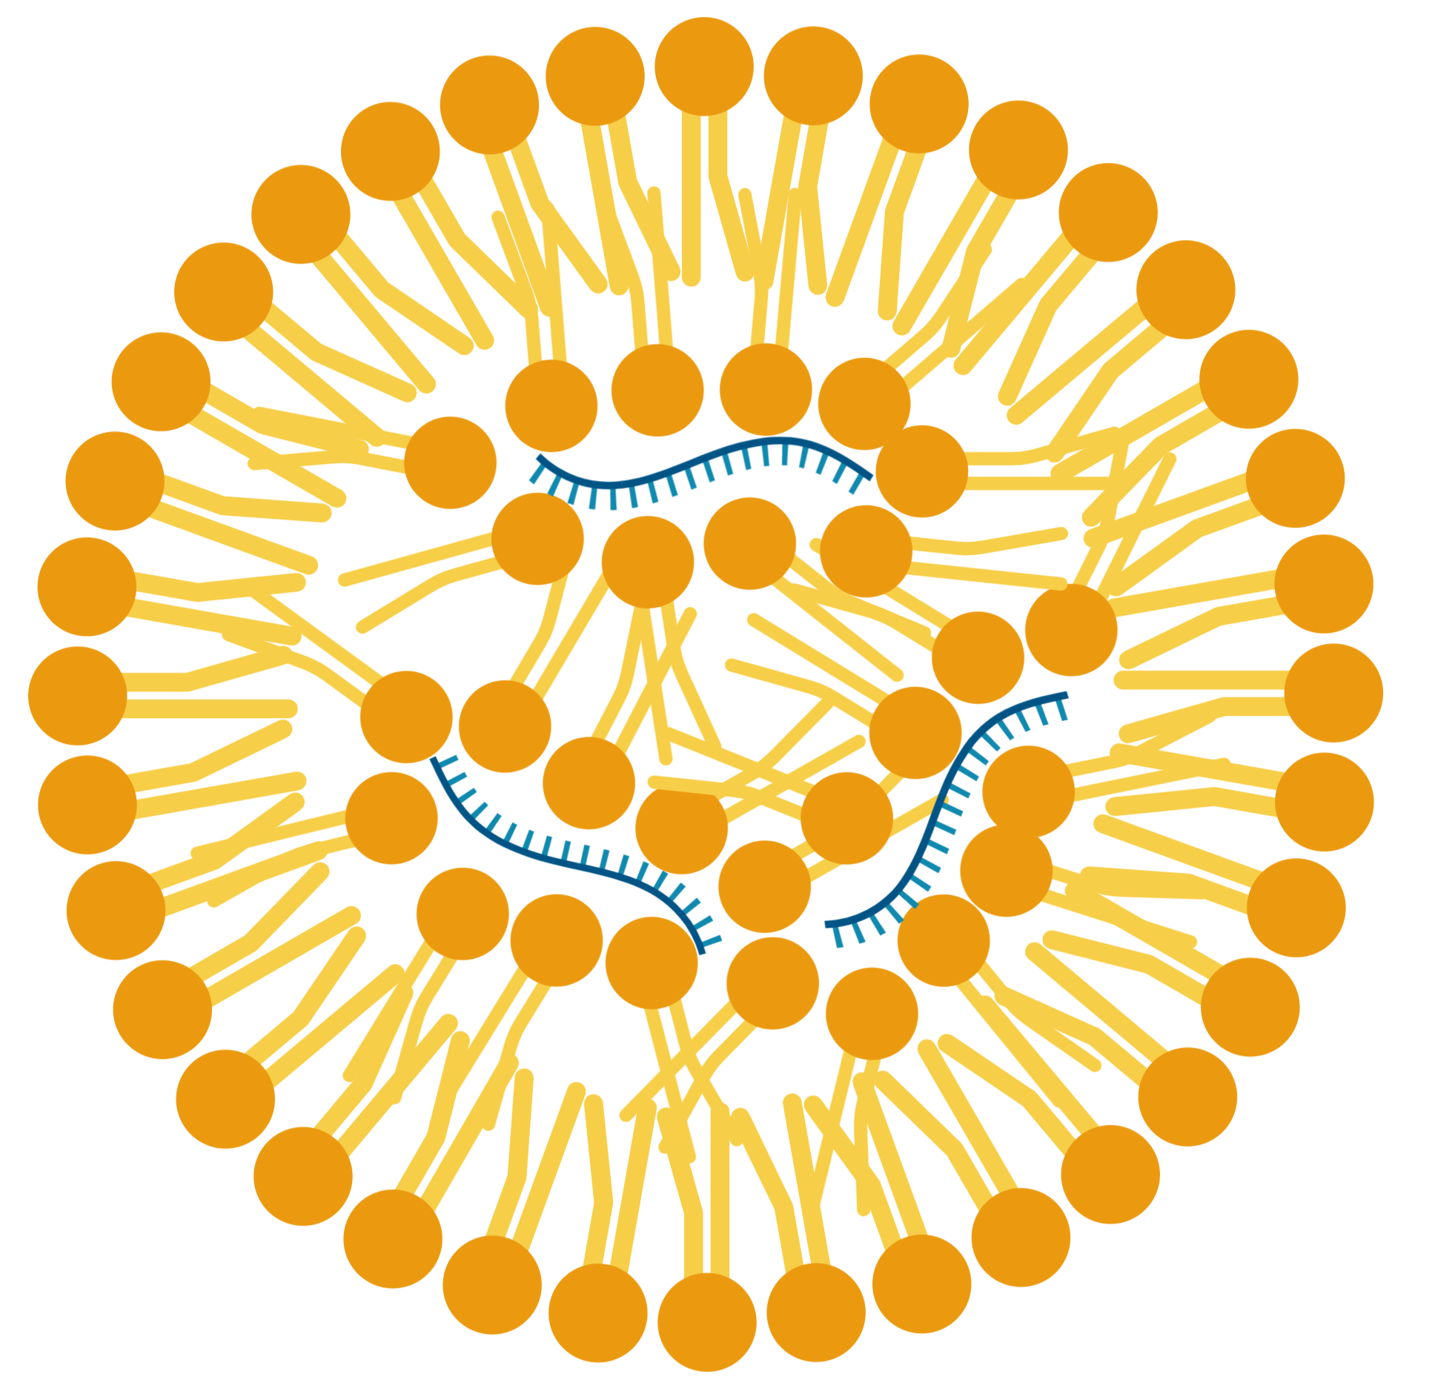
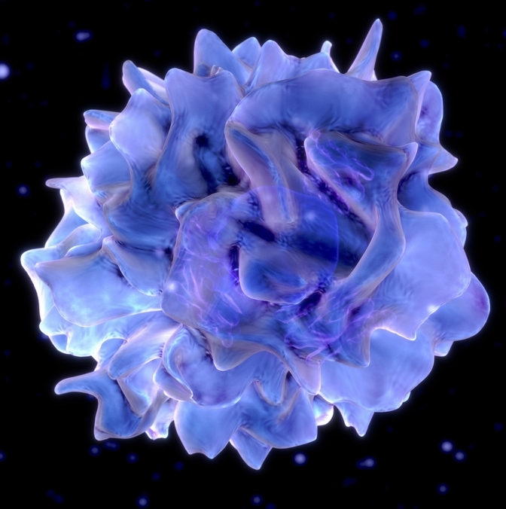
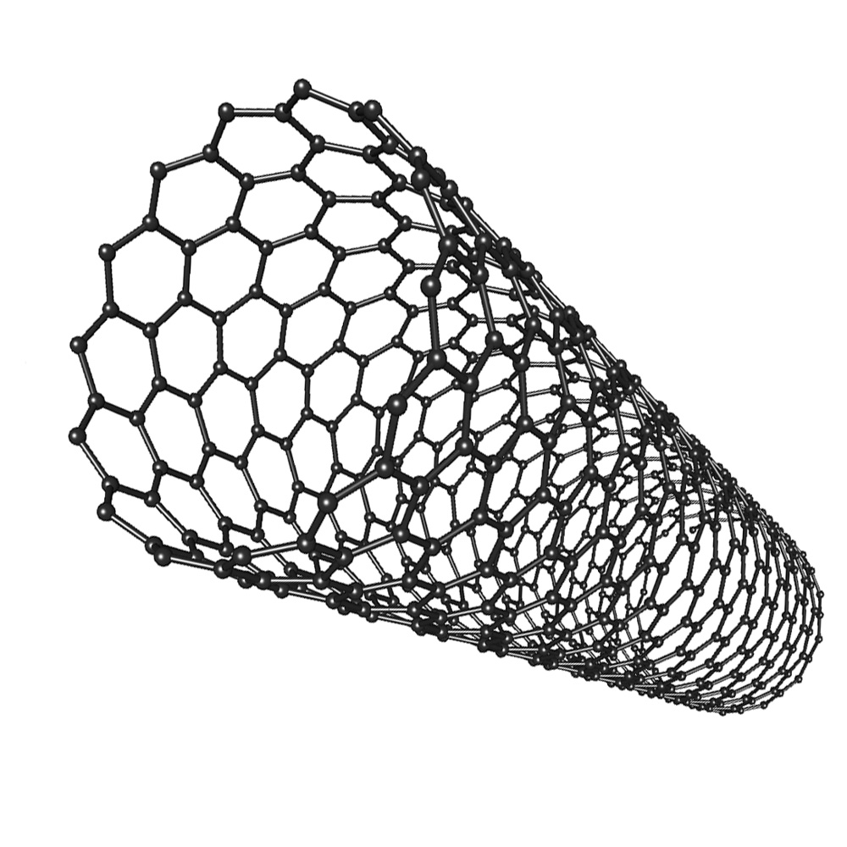
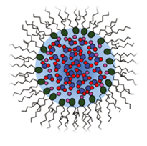
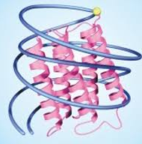
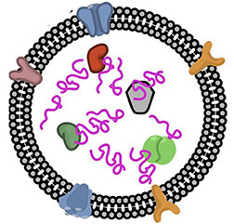
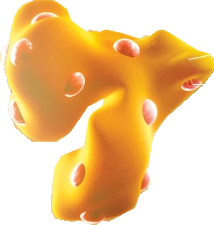
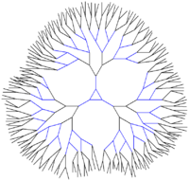
1986
Iron oxide
1996
Feridex;
MRI Imaging
1994
PEGylated Polymer NP
2012
BIND-014;
Cancer
Timeline Of Micro- And Nano-Technology for Therapeutic, Vaccine, and Imaging Applications
1970’s
Virus-like
particle
2010
HBsAg;
HPV
Vaccine
1976
Polymeric
Particles
1989
Lupron;
Endo-
metriosis
1955
Viral
Vector Therapy
2015
T-VEC; Melanoma
1963
Liposome
1995
Doxil;
Kaposi’s
sarcoma
1975
Lipid
Disks
1995
Abelcet;
Fungal
Infection
1950
Hydrogels
2002
Silicone
hydrogel
Contact
lenses
1978
Nanocrystals
2003
Emend; Antiemetic
1795
Viral
Vaccine
Predates
FDA
Smallpox Vaccine
1943
Nano/Micro Emulsions
1995
Neoral;
Cyclosporine
1964
Silica
NPs
1993
Lipid/ Nucleic
Acid NPs
2018
Onpattro; Amyloidosis
1980
Targeted PEGylated Liposome
1995
Metal
Organic Framework
1998
Microneedles
2015
Influenza Vaccine
1840
1790
1860
1880
1900
1920
1940
1960
1980
2000
2020
1953
Cell Based Therapies
2010
Provenge;
Prostate Cancer
1850
Colloidal Gold
2006
TNF-AuNP;
Head & Neck Cancer
1991
Carbon
nanotube
2005
PRINT Particles
2010
LIQ001;
Flu vaccine
1960
Polymer
micelle
2003
Estrasorb;
Menopause
1970
PEGylation
1990
Adagen; PEG-Adeonosine
Deaminase
1977
Protein/nucleic
acid NP
2018
CV7202;
Rabies Vaccine
1986
Albumin NP
2005
Abraxane;
Pancreatic Cancer
1970’s
Exosomes
2005
Dex; Lung Cancer
1980’s
Quantum
Dot
2011
Cdot; Melanoma
1987
Polyplexes
2006
DTA-H19;
Bladder Cancer
1978
Dendrimer
2010
VivaGel;
Microbicide
1995
Polymersomes
All images from Google images
Green: Date of 1st report of technology, not just for drug delivery | Yellow: Date of 1st Clinical Trial if not approved | Red: Date of FDA approval | NP = nanoparticle @AinslieLab UNC

Slide 2
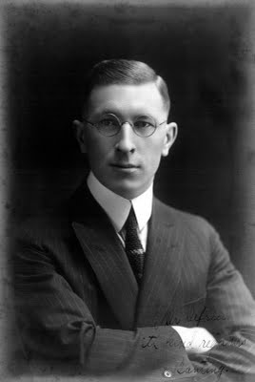
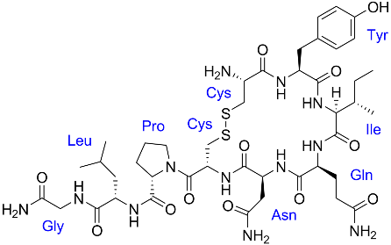
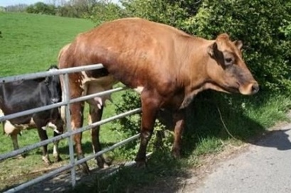
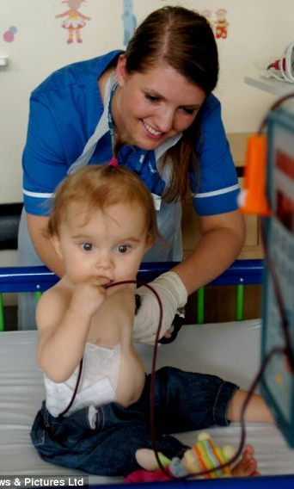
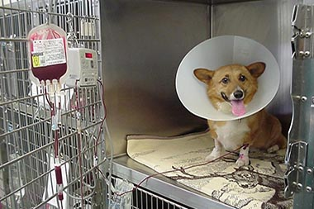
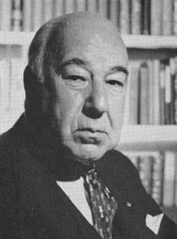
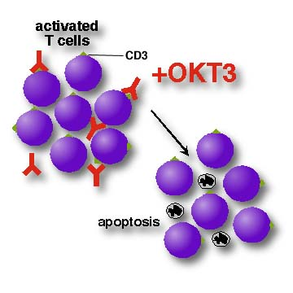
Timeline of Protein and Peptide Delivery
1667
First recorded animal to human transfusion (Dr. Denis, Paris).
1922
Banting isolates insulin from a calf pancreas and uses it to treat a child.
Approved 1980
Oxytocin was the first FDA approved peptide drug.
Approved 2005
Albumin bound compounds
Abraxane – paclitaxel bound to HAS.
Approved 2014
Eloctate, first fusion protein. Fc fused to clotting factor VIII.
1665
First blood transfusion between animals (Dr. Lower, Oxford).
1809
First human to human blood transfusion.
1940
Edwin J. Cohn, Harvard, isolated albumin from blood and pasteurized it.
Approved 1985
Muromonab-CD3 (OKT3) was developed to help acute rejection of transplanted organs.
Approved 2010
Hepatitis B virus surface antigen (HBsAg) virus-like particle vaccine.
Starr, Blood: An Epic History of Medicine and Commerce. 2002
Notes:
First protein delivery was performed during blood transfusion. The first recorded successful blood transfusion occurs in England: Physician Richard Lower kept dog alive by transfusing blood from other dogs.
Jean Bapsiste Denis, the physician of Louis XIV, had been studying the transfer of animal to human blood. He took a local vagrant who, by his distribution, suffered “phrensies” where she would beat his wife, strip off his clothes and run around the streets, and transfused a café’s blood into the vagrant’s vein. He hoped the calf’s blood would “by its mildness and freshness…allay the heat and ebullition of the patient’s blood.” The patient complained of heat up his arm as he was transfused, passed out for 2 hours and awoke fine. Two days later Denis repeated the transfustion. With the second transfustion, the patient had mild shock, including urinating black fluids, and vomiting. He pass out until morning and continued these symptoms for almost 3 days. At the end of three days Denis reported that the patient attended his wife and was improved in his disposition to her – essentially he regarded the treatments as a success. The Paris society of physicians ultimately outlawed animals to humans blood transfusions in 1678 because of numerous adverse reactions, many resulting in death.
1809 blood transfusion from father to infant. The father was a MD at Columbia University. Dr. Alexis Carrel of Rockefeller Institute of Medical Research had been studying vessels and was called by the father to help. The baby had been bleeding out of her nose and lost copious amounts of blood. The baby was saved by the transfusion. Blood types were identified almost 100 years later in 1900’s by Karl Landsteiner in Vienna. He noticed if you mix blood together, sometimes it clotted and other times it did not, thus the + and – Rh factors. Also he grouped them by letters A, B, and C. C was later changed to O – the universal blood type. Type AB came up later. Landsteiner received the Nobel prize.
Insulin: Prior to 1920’s Children would be comatosed in large hospital wards dying from diabetic keto-acidosis, due to lack of insulin and the Family would sit by their bedside until they died. January 11, 1922 Canadian Frederick Banting and Charles Best injected insulin from a calf pancreas into a 14 year old boy (after testing in dogs) - First injection – allergic reactions -- Second injection (two weeks later) – glycosuria eliminated
In April 1922, Eli Lily and company offered to purify the protein for therapy. Banting and other researchers involved received the Nobel Prize in 1923. Banting was squatting in Best’s lab to do his work because it was considered too risky for a university to give him his own lab to do the work. Insulin is largely considered a peptide over a protein since it is so small, (5808 Da)
Just before WWI, Edwin Cohn was working on isolating proteins from blood. By the time WWI had started, ampules of albumin were used by battlefield doctors because they were more accessible than transfusions. The medic would break open the ampule into the wound of the solider. WWII marked the first use of blood and plasma transfusions once the patients were back at the base receiving medical care. People with type O blood at the home-front and battlefront would generously donate blood for the war effort.
Oxytocin was the first Peptide drug. Oxytocin is an intravenous infusion of oxytocin is used to induce labor. It was approved in 1980.
Muromonab-CD3 (trade name Orthoclone OKT3, marketed by Janssen-Cilag) is an immunosuppressant drug given to reduce acute rejection in patients with organ transplants.^{[1][2]} It is a monoclonal antibody targeted at the CD3 receptor, a membrane protein on the surface of T cells. It was the first monoclonal antibody to be approved for clinical use in humans. However, the manufacturer of Muromonab-CD3 have voluntarily withdrawn^{[4]} it from the United States market due to decreased utilization; current OKT3 supplies are expected to be exhausted by mid-2010.
- Eloctate, Antihemophilic Factor (Recombinant), Fc fusion protein, for use in adults and children who have Hemophilia A. Eloctate is the first Hemophilia A treatment designed to require less frequent injections when used to prevent or reduce the frequency of bleeding.
Eloctate is approved to help control and prevent bleeding episodes, manage bleeding during surgical procedures, and prevent or reduce the frequency of bleeding episodes (prophylaxis). Eloctate consists of the Coagulation Factor VIII molecule (historically known as Antihemophilic Factor) linked to a protein fragment, Fc, which is found in antibodies.

