Slide 1
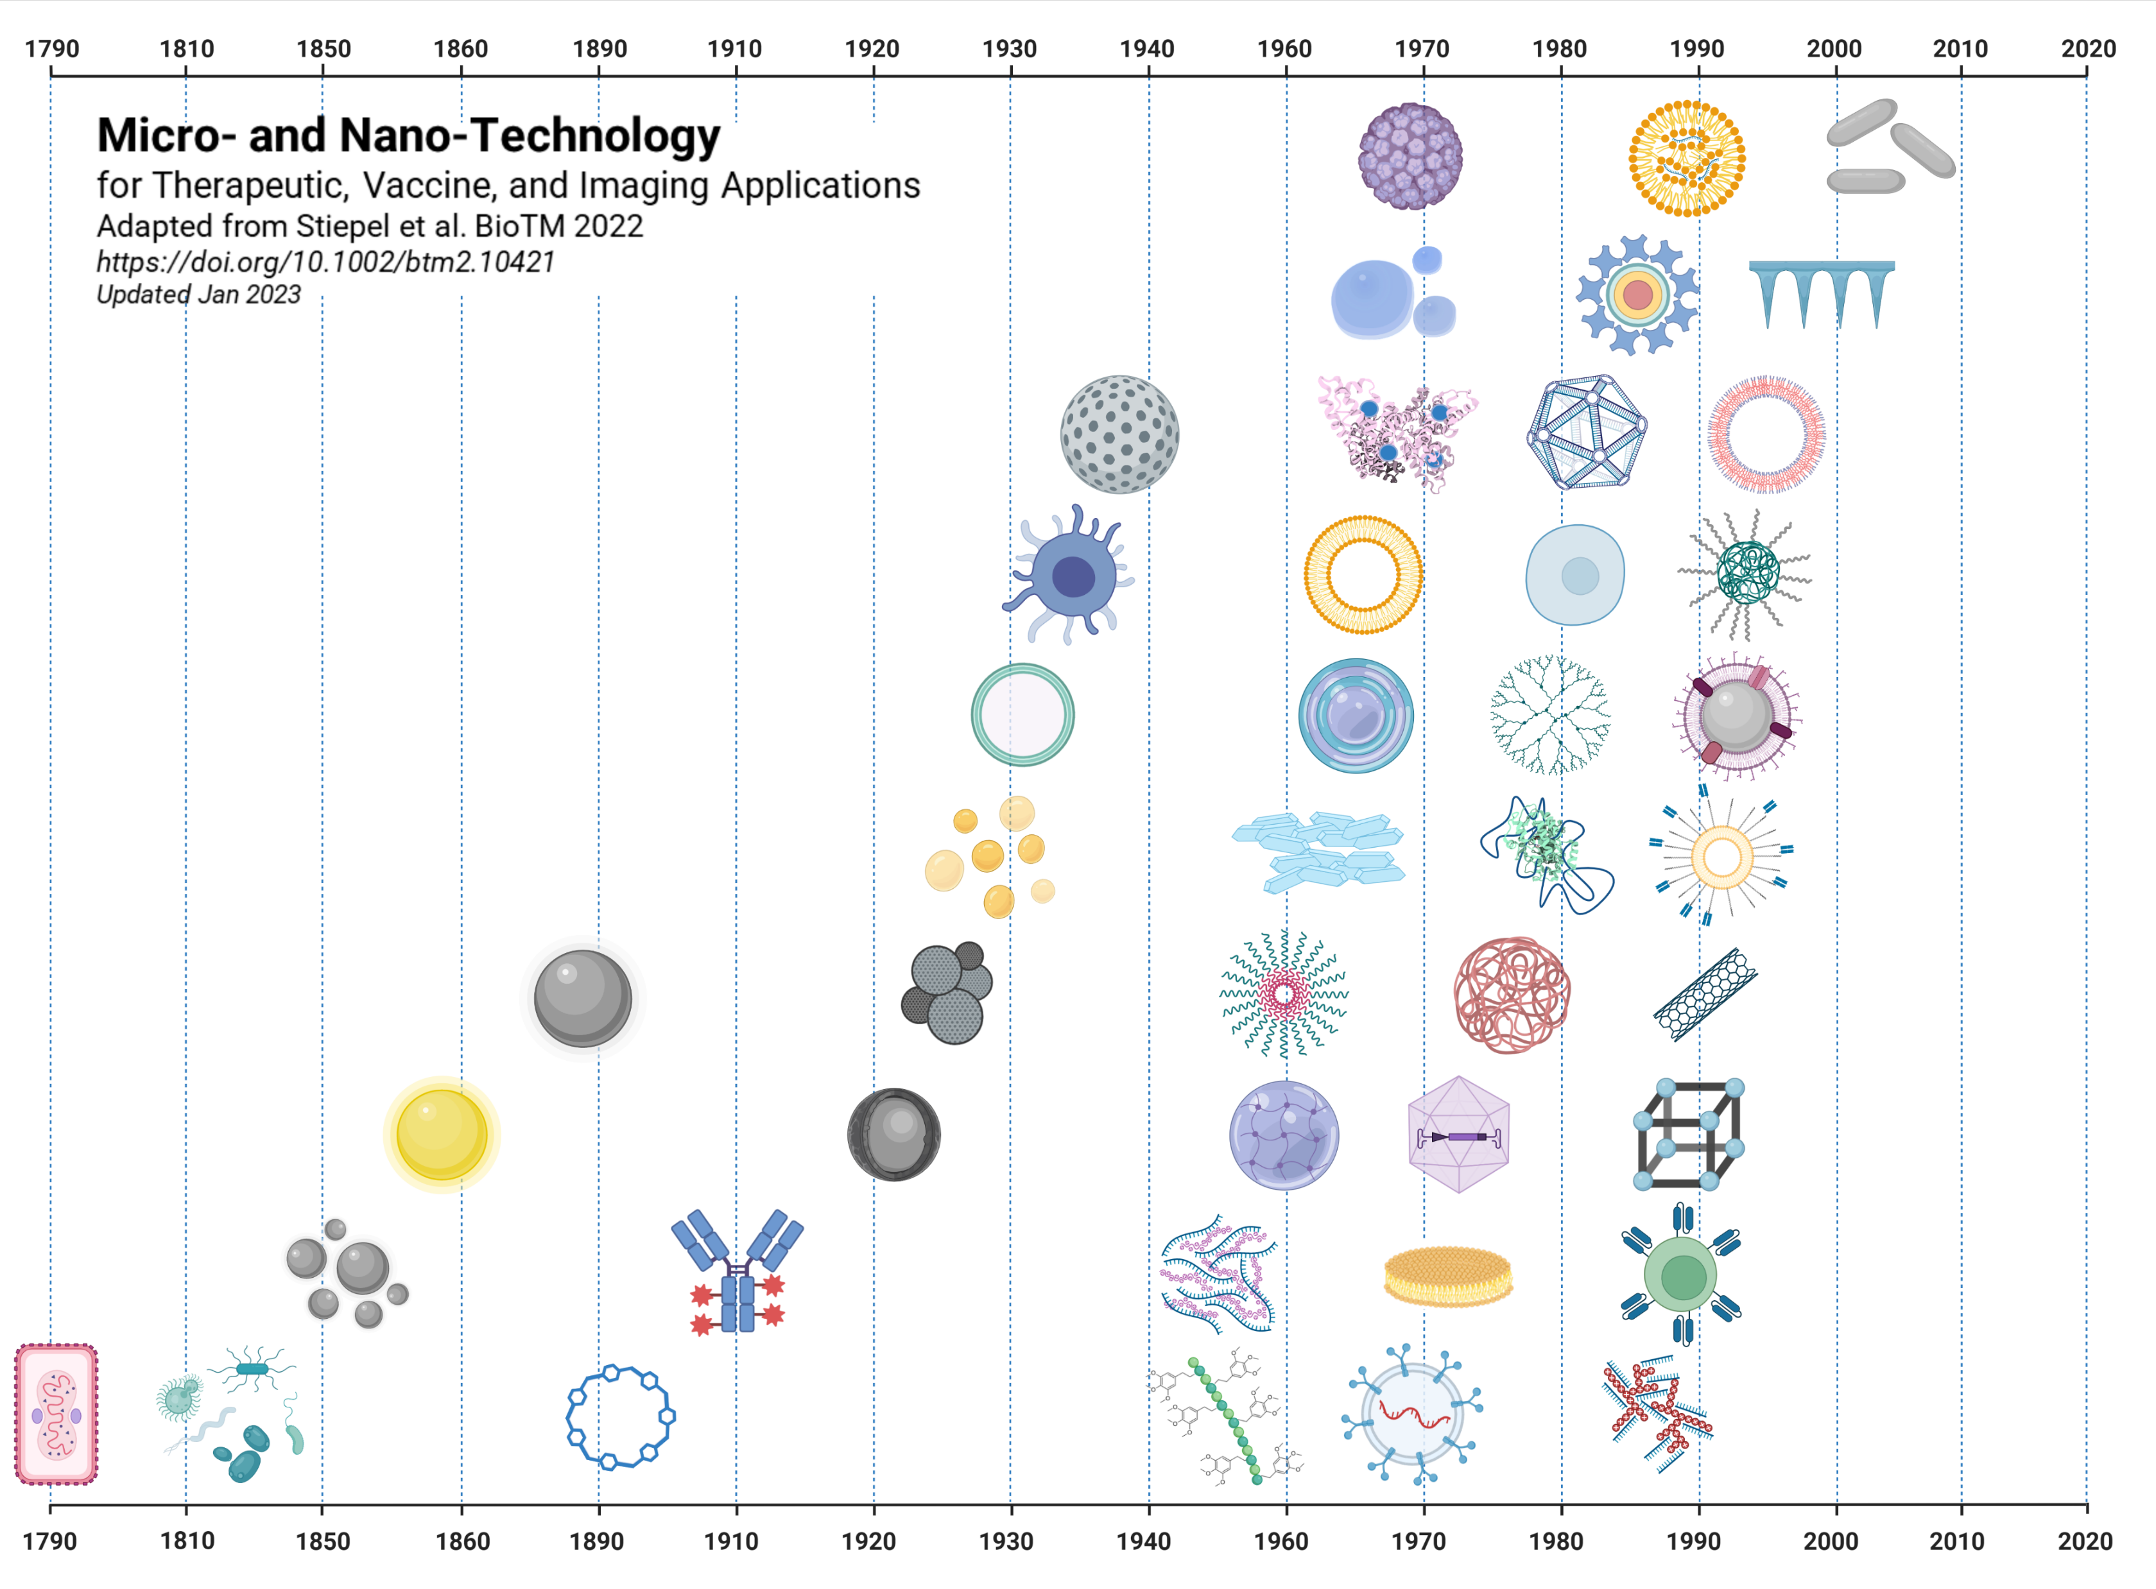
Virus-like
Particle
Lipid/Nucleic
Acid NPs
PRINT
Particles
Quantum
Dot
Microbubbles
DNA
Origami
Microneedles
Porous Silica
Albumin
NP
Polymersomes
Mammalian
Cell Based Therapies
Stem
Cells
Liposome
PEGylated
Polymer NP
Dendrimer
Minicell
Layer-by-Layer
Membrane
Coated NPs
Emulsions
PEGylation
Nanocrystals
Targeted PEGylated Liposome
Colloidal
Silver
Polymeric
Particles
Alum
Polymer
Micelle
Carbon
Nanotube
Colloidal
Gold
Hafnium
NPs
Viral
Vector
Hydrogels
Metal
Organic
Framework
Antibody
Drug Conjugate
Iron Oxide NPs
Lipid Discs
Protein/
Nucleic
Acid NP
CAR T cells
Viral
Vaccine
Exosomes
Cyclodextrin
Polymer
Drug
Conjugate
Polyplexes
Non-Viral
Microbes
Made in Biorender

Slide 2
Porous Silica
Microneedles
Colloidal
Silver
Carbon
Nanotube
Colloidal
Gold
Metal
Organic
Framework
Alum
Hafnium
NPs
Iron Oxide NPs
Quantum
Dot
Made in Biorender

Slide 3
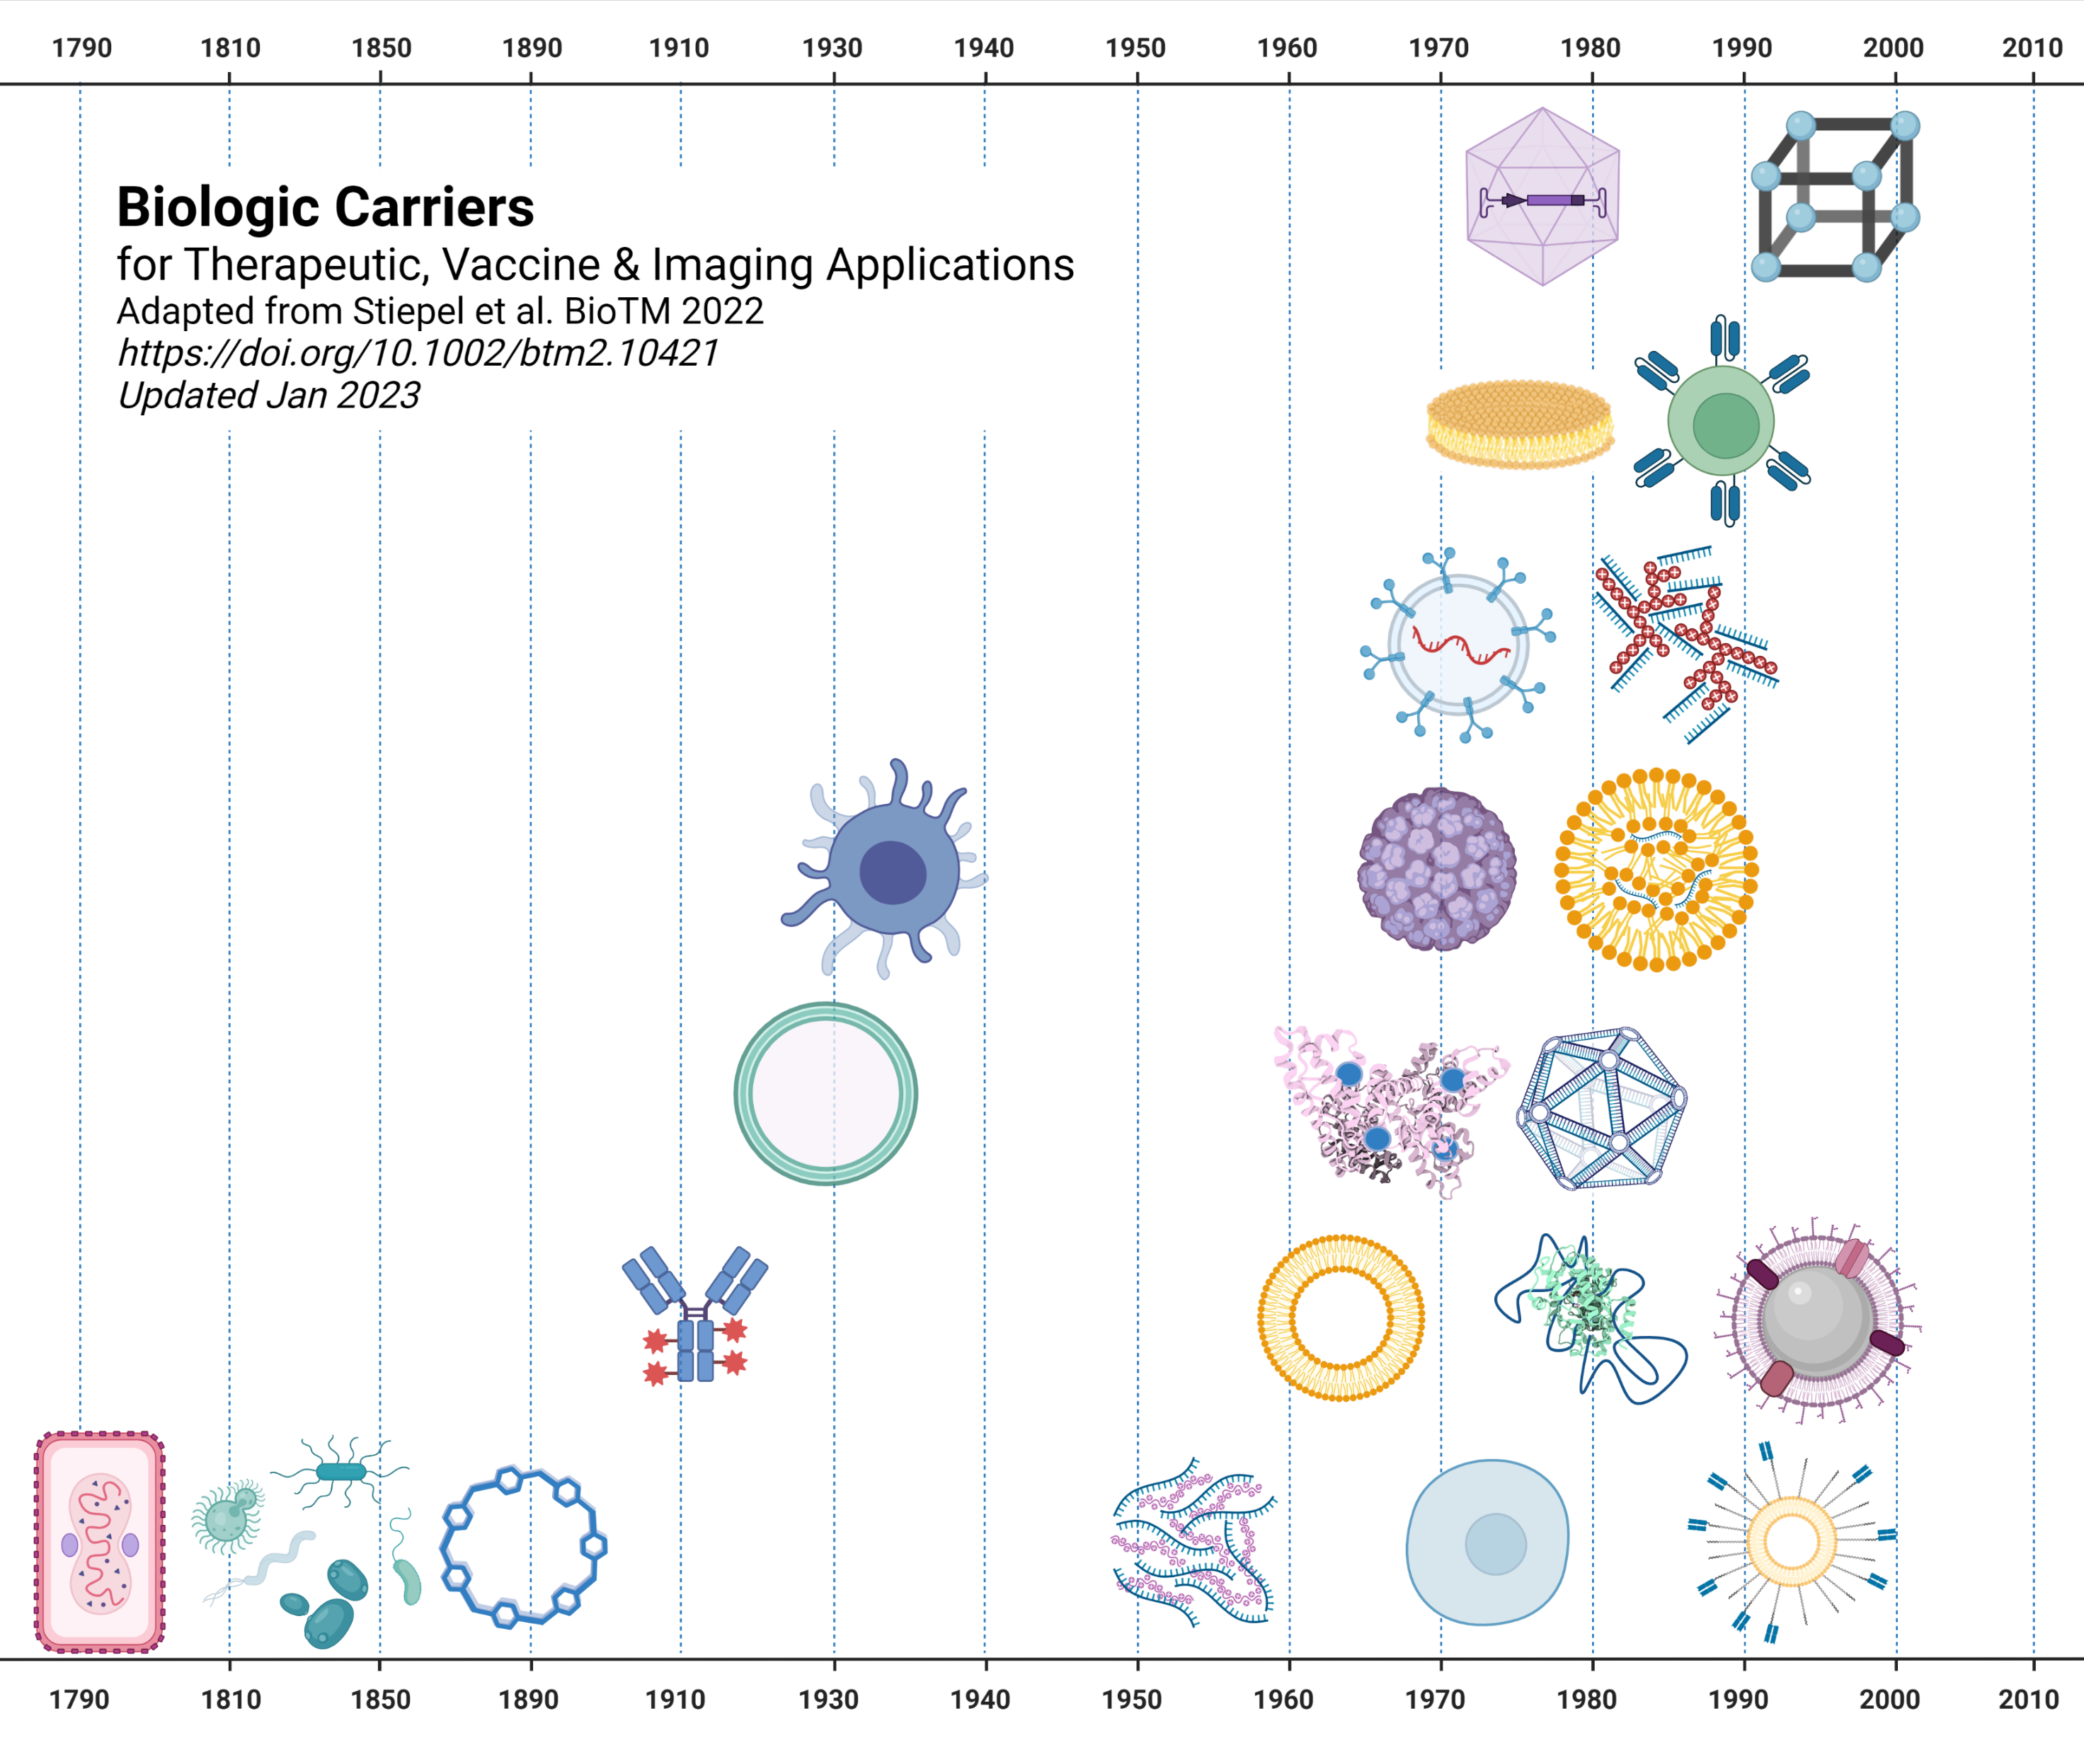
Viral
Vector
Metal
Organic
Framework
Lipid Discs
CAR T cells
Exosomes
Polyplexes
Mammalian
Cell Based Therapies
Virus-like
Particle
Lipid/Nucleic
Acid NPs
Minicell
Albumin NP
DNA
Origami
Antibody
Drug Conjugate
Liposome
Membrane
Coated NPs
Viral
Vaccine
Non-Viral
Microbes
Cyclodextrin
PEGylation
Protein/
Nucleic
Acid NP
Stem
Cells
Targeted PEGylated Liposome
Made in Biorender

Slide 4
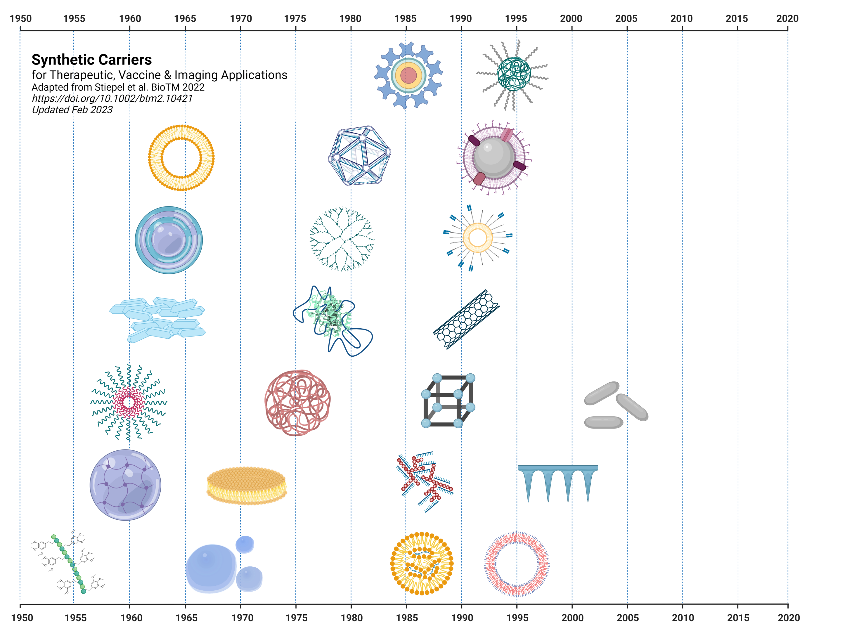
Quantum
Dot
PEGylated
Polymer NP
DNA
Origami
Membrane
Coated NPs
Liposome
Dendrimer
Layer-by-Layer
Targeted PEGylated Liposome
PEGylation
Nanocrystals
Carbon
Nanotube
Metal Organic
Framework
Polymer
Micelle
Polymeric
Particles
PRINT
Particles
Polyplexes
Hydrogels
Microneedles
Lipid Discs
Lipid/Nucleic Acid NPs
Polymer
Drug
Conjugate
Microbubbles
Polymersomes
Made in Biorender

Slide 5
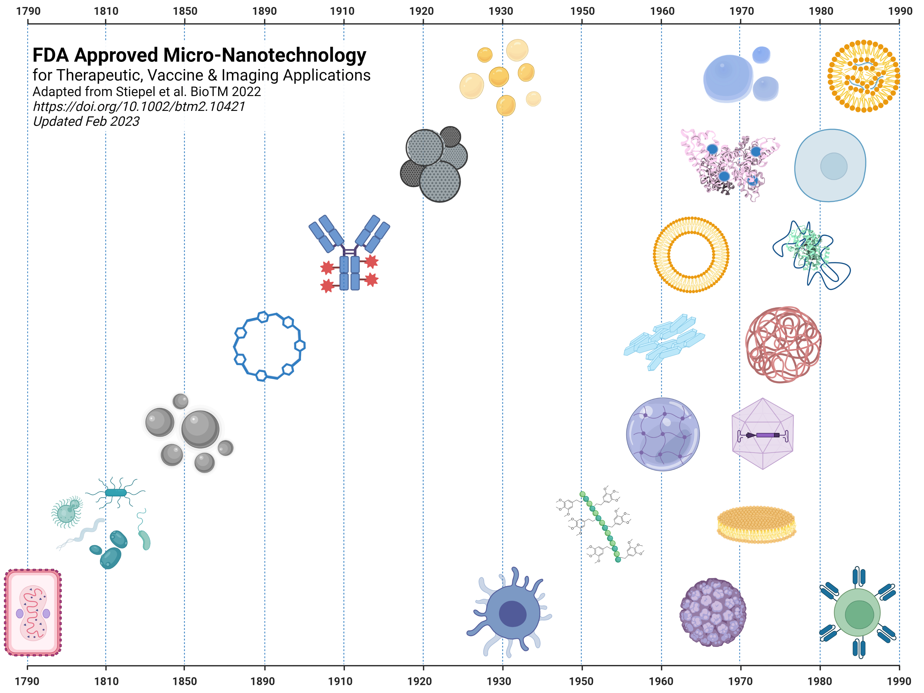
Emulsions
Intralipid
1975
Microbubbles
Optison
1997
Lipid/Nucleic Acid NPs
Onpattro
2018
Albumin NP
Abraxane
2005
Date of FDA approval & name of product.
Stem
Cells
Hemacord
2011
Antibody Drug Conjugate
Adcetris
2011
Alum
Diphtheria Vaccine
1932
Liposome
Doxil
1995
PEGylation
Adagen
1990
Cyclodextrin
Beta-cyclodextrin
1992
Nanocrystals
Emend
2003
Polymeric Particles
Lupron depot
1989
Iron Oxide NPs
Feridex
1992
Hydrogels
Soflens
1971
Viral Vector
T-VEC
2015
Non-Viral Microbes
Rebyota
2022
Polymer Drug Conjugate
Adcetris
2011
Lipid Discs
Amphotec
1996
Mammalian
Cell Based Therapies
Provenge
2010
Virus-like
Particle
Engerix-B
1989
Viral Vaccine
Approved
Pre-FDA
CAR T cells
Kymriah
2017
Made in Biorender

