Slide 1
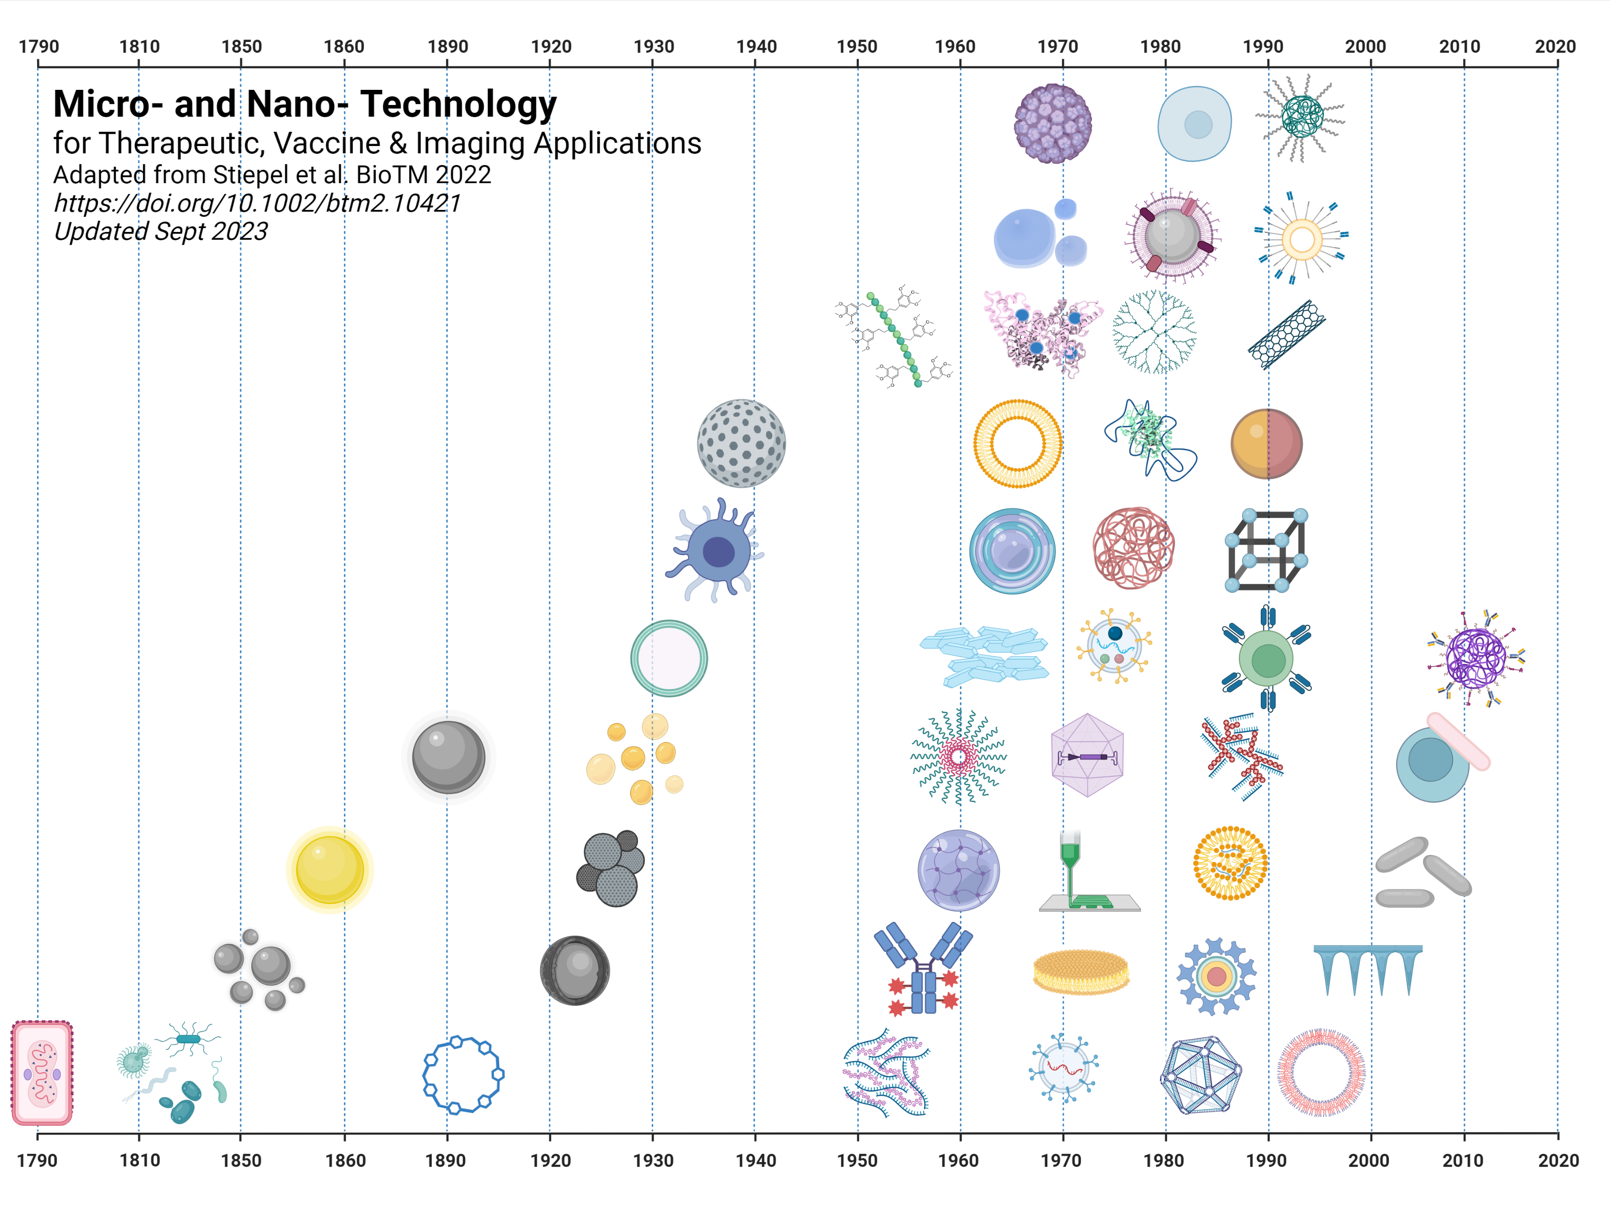
Virus-like
Particle
Stem
Cells
PEGylated
Polymer NP
Microbubbles
Membrane Coated NPs
Targeted PEGylated Liposome
Polymer
Drug
Conjugate
Albumin
NP
Carbon
Nanotube
Dendrimer
Porous Silica
Liposome
Janus
Particles
Mammalian
Cell Based Therapies
PEGylation
Layer-by-Layer
Metal
Organic
Framework
Minicell
Polymeric Particles
Nanocrystals
CAR T cells
Heteromultivalent
Particles
Colloidal
Silver
Emulsions
Microvesicles
Polymer
Micelle
Cell
Backpack
Colloidal
Gold
Viral Vector
Polyplexes
Alum
PRINT
Particles
Hydrogels
Iron Oxide NPs
Hafnium
NPs
3D Printing
Lipid/Nucleic Acid NPs
Viral
Vaccine
Antibody
Drug Conjugate
Microneedles
Cyclodextrin
Lipid Discs
Quantum Dot
Protein/
Nucleic
Acid NP
Non-Viral
Microbes
Polymersomes
Exosomes
DNA Origami
Made in Biorender

Slide 2
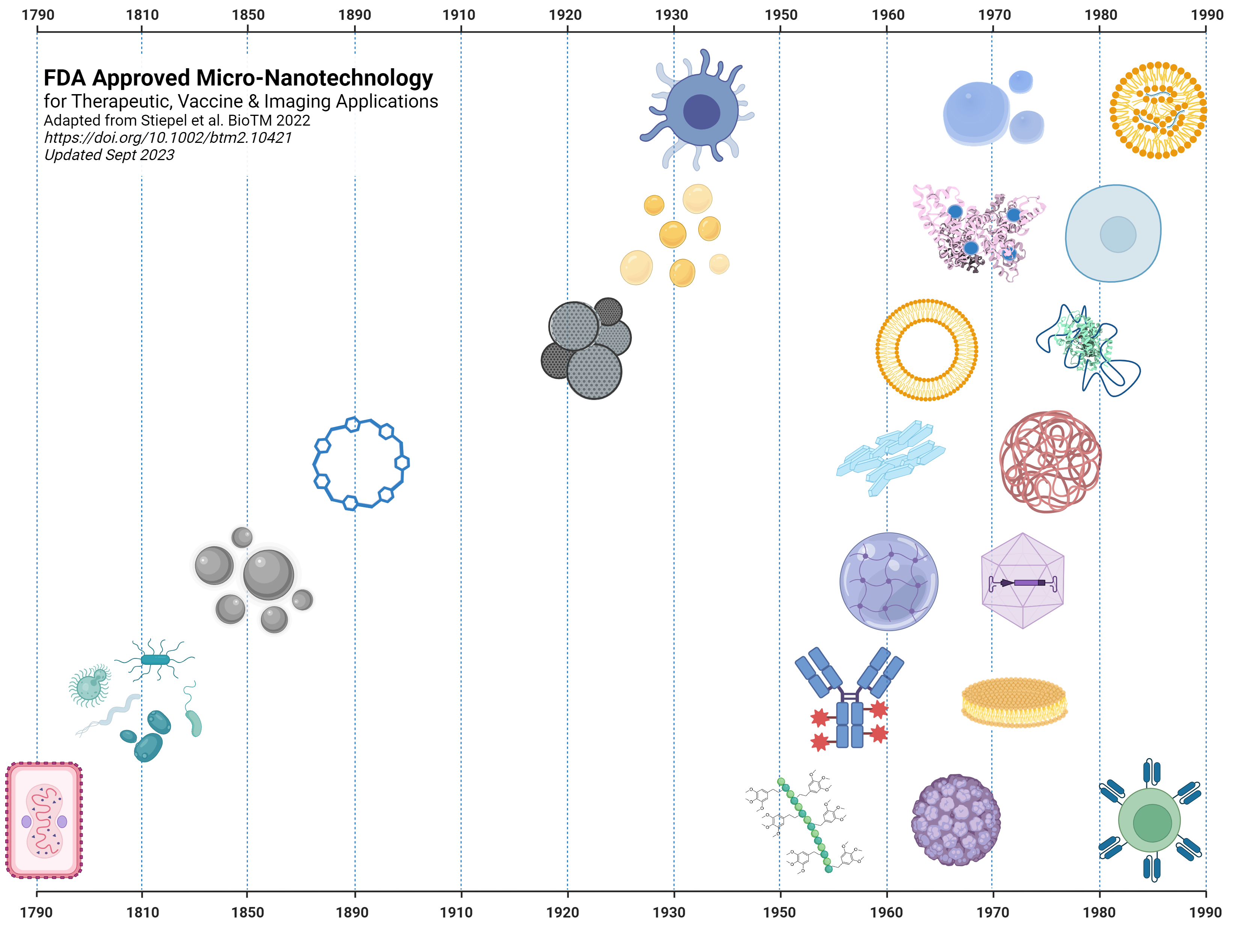
Mammalian
Cell Based Therapies
Provenge
2010
Microbubbles
Optison
1997
Lipid/Nucleic Acid NPs
Onpattro
2018
Albumin NP
Abraxane
2005
Date of FDA approval & name of product.
Stem
Cells
Hemacord
2011
Emulsions
Intralipid
1975
Liposome
Doxil
1995
PEGylation
Adagen
1990
Cyclodextrin
Beta-cyclodextrin
1992
Alum
Diphtheria Vaccine
1932
Nanocrystals
Emend
2003
Polymeric Particles
Lupron depot
1989
Iron Oxide NPs
Feridex
1992
Hydrogels
Soflens
1971
Viral Vector
T-VEC
2015
Non-Viral Microbes
Rebyota
2022
Antibody Drug Conjugate
Adcetris
2011
Lipid Discs
Amphotec
1996
Polymer Drug Conjugate
Naloxegol
2014
Virus-like
Particle
Engerix-B
1989
Viral Vaccine
Approved
Pre-FDA
CAR T cells
Kymriah
2017
Made in Biorender

Slide 3
Additions since Stiepel et al. (https://aiche.onlinelibrary.wiley.com/doi/full/10.1002/btm2.10421)
Silver NPs (1889)
Nowack B, Krug HF, Height M. 120 years of nanosilver history: implications for policy makers. Environ Sci Technol. 2011 Feb 15;45(4):1177-83.
Polymer drug conjugate (1955)
Pradip Thakor, Valamla Bhavana, Reena Sharma, Saurabh Srivastava, Shashi Bala Singh, Neelesh Kumar Mehra. Polymer–drug conjugates: recent advances and future perspectives. Drug Discovery Today. Volume 25, Issue 9. 2020. Pages 1718-1726.
Antibody-drug conjugates (1957)
Fu, Z., Li, S., Han, S. et al. Antibody drug conjugate: the “biological missile” for targeted cancer therapy. Sig Transduct Target Ther 7, 93 (2022).
3D Printing (1971)
https://patents.google.com/patent/US3596285A/en
Microvesicles (1975)
https://www.ncbi.nlm.nih.gov/pmc/articles/PMC8681215/
Membrane coated particles (1981)
E. Evans, K. Buxbaum. Affinity of red blood cell membrane for particle surfaces measured by the extent of particle encapsulation. Biophysical Journal, Volume 34, Issue 1, 1981, Pages 1-12.
Janus particles (1989)
C. Casagrande, P. Fabre, E. Raphaël, and M. Veyssié. "Janus Beads": Realization and Behaviour at Water/Oil Interfaces. EPL 9 251. DOI 10.1209/0295-5075/9/3/011
Cell Backpack (2008)
Swiston AJ, Cheng C, Um SH, Irvine DJ, Cohen RE, Rubner MF. Surface functionalization of living cells with multilayer patches. Nano Lett. 2008 Dec;8(12):4446-53.
Heteromultivalent Nanoparticles (2012)
https://patents.google.com/patent/US9107963B2/en

